Slide 1

Software Requirement Engineering
Part II: Software Requirements Development
Week # 12

Slide 2
Event-Response Tables
Another way to organize and document user requirements is to identify the external events to which the system must respond. An event is some change or activity that takes place in the user’s environment that stimulates a response from the software system (McMenamin and Palmer 1984; Wiley 2000).
An event-response table (also called an event table or an event list) lists all such events and the behavior the system is expected to exhibit in reaction to each event.

Slide 3
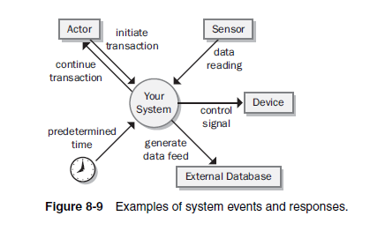
Event-Response Tables
There are several types of system events, as shown in Figure :
Notes:
An action by a human user that stimulates a dialog with the software, as when the user initiates a use case (sometimes called a business event). The event-response sequences correspond to the dialog steps in a use case. Unlike use cases, the event-response table does not describe the user’s goal in using the system or state why this event response sequence provides value to the user.
A control signal, data reading, or interrupt received from an external hardware device, such as when a switch closes, a voltage changes, or the user moves the mouse.
A time-triggered event, as when the computer’s clock reaches a specified time (say, to launch an automatic data export operation at midnight) or when a preset duration has passed since a previous event (as in a system that logs the temperature read by a sensor every 10 seconds).

Slide 4
Event-Response Tables
Event-response tables are particularly appropriate for real-time control systems.
Note that the expected response depends not only on the event but also on the state the system is in at the time the event takes place.
The event-response table records information at the user-requirements level. If the table defines and labels every possible combination of event, state, and response (including exception conditions), the table can also serve as part of the functional requirements for that portion of the system.
However, the analyst must supply additional functional and nonfunctional requirements in the SRS.
Notice that the events listed in Table 8-1 are written at the essential level (describing the essence of the event), not at the implementation level (describing the specifics of the implementation).
Notes:
For instance, events 4 and 5.1 in Table 8-1 result in slightly different behaviors depending on whether the wipers were on at the time the user set the wiper control to the intermittent setting.
A response might simply alter some internal system information (events 4 and 7.1 in the table) or it could result in an externally visible result (most other events).

Slide 5
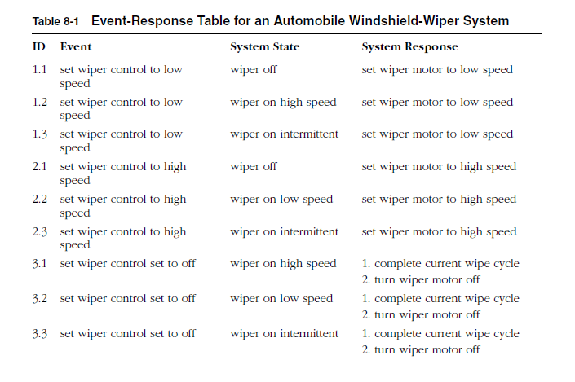
Event-Response Tables

Slide 6
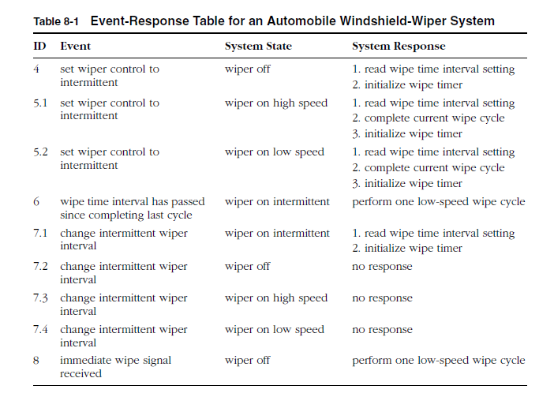
Event-Response Tables

